Slide 1


Finding the right job has become a full-time job
"Job seekers don't need more job boards.
They need intelligence."

Slide 2




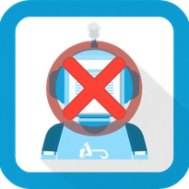

Key Pain Points in Job Searching
Job postings scattered across multiple channels
Job title searches miss relevant opportunities
Difficulty identifying compatible positions
Lack of control over applications, status tracking & documents
ATS systems reject candidates due to missing keywords
Resume & cover letter need customization for each application

Slide 3
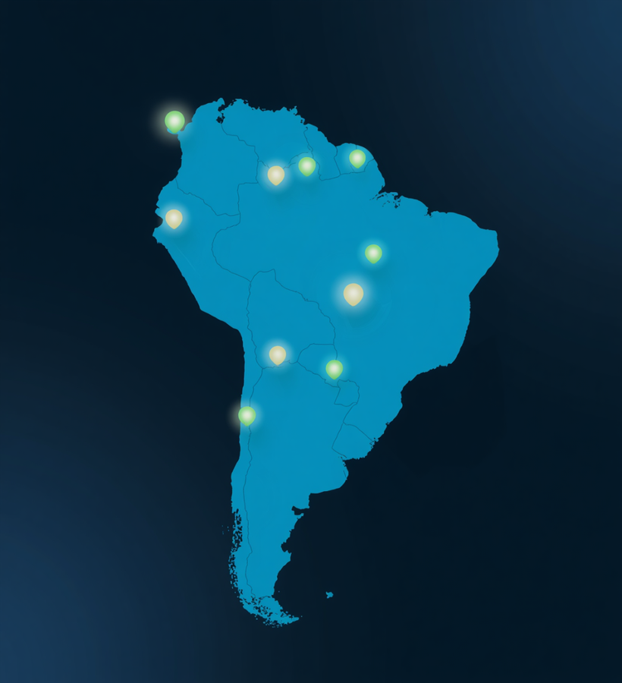
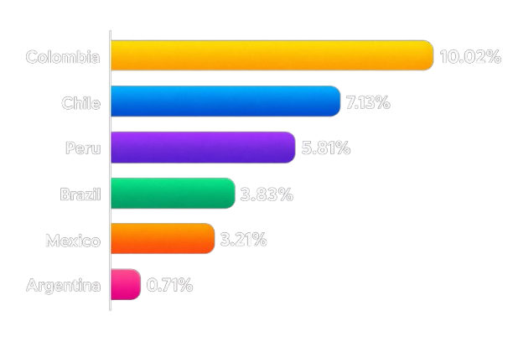
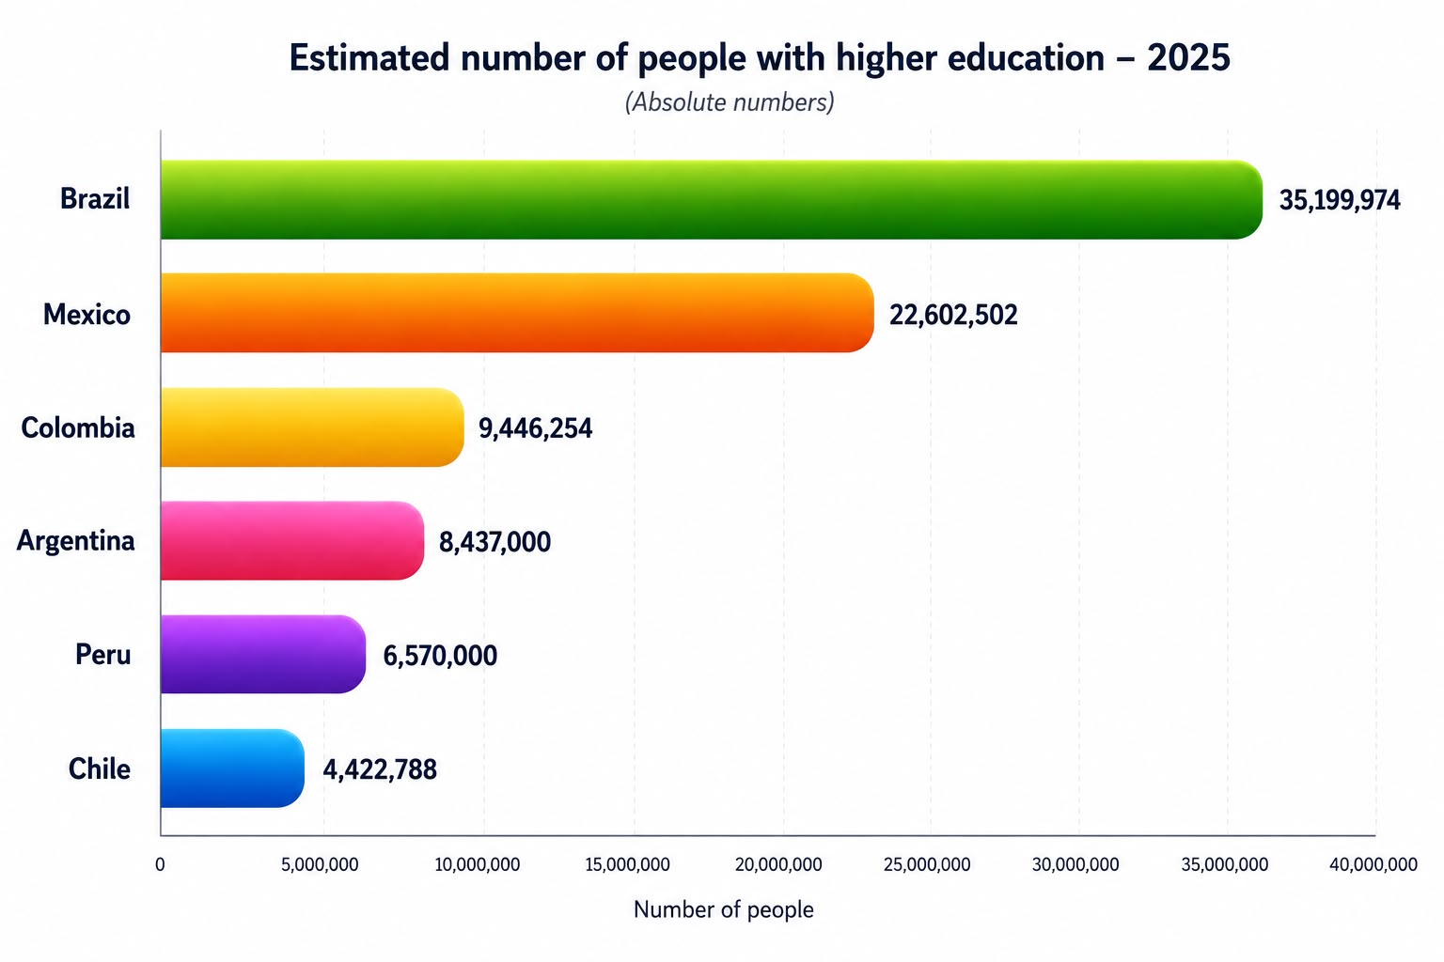
A Massive opportunity
in Latin America
86M+
Annual unemployment rate among people with a bachelor's degree or higher 2025
Qualified Professionals
Latin America
Source: ILOSTAT / ILO. Indicator: Unemployment rate by sex and education (%). Annual. 2025

Slide 4
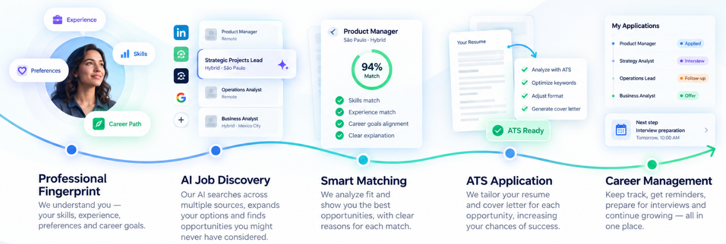
How It Works
From your profile to new opportunities —
an intelligent journey.

Slide 5

The Future of intelligent career management
FASE 2 — Career Intelligence (2027–2028)
• Skills Gap Analysis & Learning Paths
• Salary Intelligence & Negotiation Tools
• Interview Preparation AI Coach
• AI Language Assessment
"Job seekers don't need more job boards.
They need intelligence."

